Slide 1

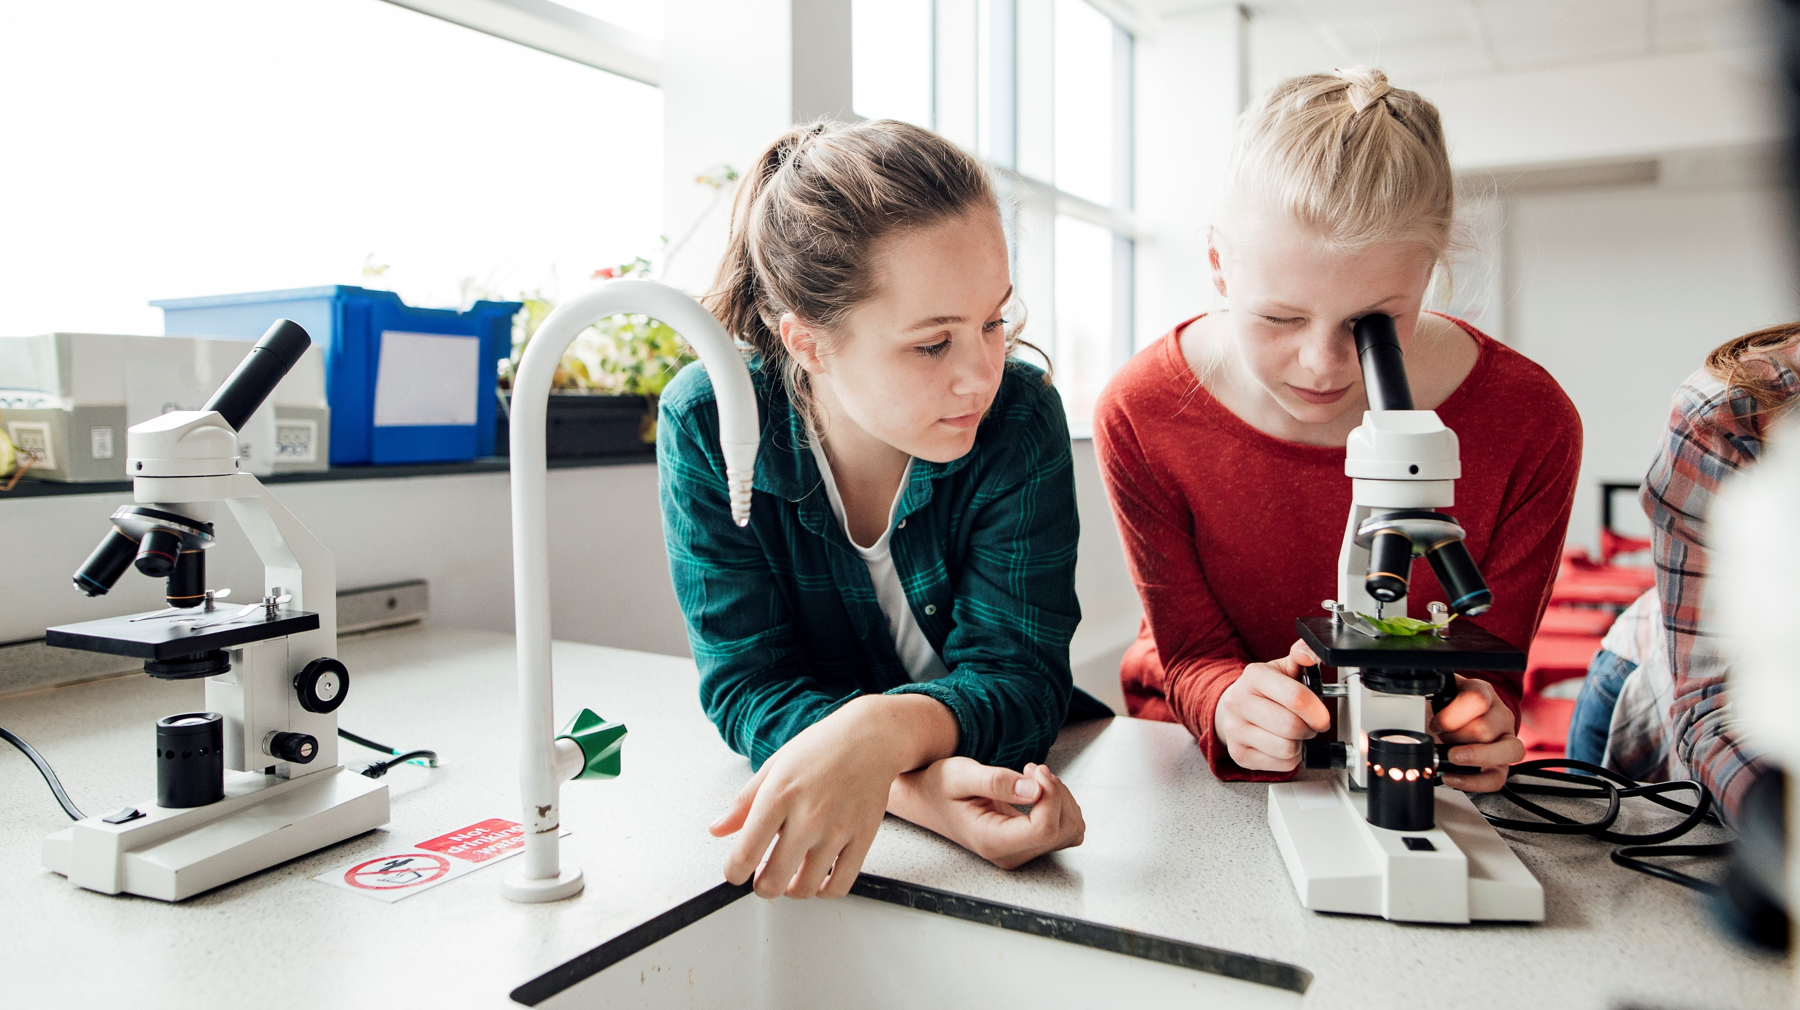
E-Books: The benefits of Modernization
Notes:
- Introduction and purpose
- Emphasize focus: benefits of modernizing textbooks through e-books and classroom technology
- Briefly describe how technology is changing classroom learning experiences.

Slide 2
Objectives
What we’ll cover today:
Explore district spending on textbooks
Review savings through e-book modernization
discuss non-monetary benefits of change
Look at evidence of technology & e-books
See success stories of districts like yours
Learn how e-books help students and parents work together
Notes:
Review objectives
Financial, educational, and collaborative benefits.

Slide 3
Costs of traditional Textbooks
Costs by Number of Enrolled Students: Elementary School: 1,632 x $203.74 = $332,503.68
Middle School: 856 x $293.17 = $250,953.52
High School: 1, 218 x $318.88 = $388, 395.84
Total Cost: $971,853.04
2022 K-12 Textbook Sales Statistics
2024 Sycamore School District Numbers
Notes:
2022 data on total district spending on textbooks
2024 student information from local school district (e.g. audience)
- Per-student costs by elementary, middle, and high school
- Not including replacement/damage costs

Slide 4
E-book cost savings
Cost of textbooks: $971,853.04
*Not including replacement/damage fees of $30-120 per book
Cost of E-books: $971,853.04 x 53% = $515,082.11
*Publicschoolreview.com study found digital textbooks are 53% cheaper
Total savings: $456,770.93
Notes:
- Cost savings from e-books
- PublicSchoolReview.com: e-books are 53% cheaper.
- Calculated total savings: ~$456,770 annually.
- Comment on additional savings from reduced replacement costs, less hours needed to collect and stack and store books from multiple teachers

Slide 5



Non-monetary benefits
Health:
Average high school backpack weight = 16-20 pounds!
*Study on Weight of Textbooks
Environmental:
30 MILLION trees saved annually
*Study by the University of Michigan
Timeliness:
Digital content updated in real-time vs 3-4 years for “new editions”
*Study on publisher releases
Notes:
Student health: reduced backpack weight
Environment: University of Michigan study found 30 million trees saved annually
Timeliness: digital content updated instantly vs. 3-4 years for new print editions

Slide 6
Technology Modernization advantages
Digital Transformation in K-12 Education
Notes:
Technology modernization benefits
Student engagement goes way up because of more access, less forgetting, up-to-the minute studying and searches
- Other benefits such as continued improvements to netbooks/chromebooks as the future moves on

Slide 7
Success of digital books
Lorain city schools (Lorain, OH):
Initiative to switch to e-books, netbooks and student accessibility
$1.1 million on e-books & $700,000 on netbooks vs $3 million on textbooks
$1.2 million in savings and 4-5 years of netbook usage
Rancho Christian (Temecula, CA):
New school opening with new programs
Access to many ‘free domain’ works in a virtual library instead of costly textbooks
Immediate student popularity
Full school control and accesses
Districts Save Money on Digital Textbooks
Notes:
- Lorain City Schools case study
Rancho Christian case study
Cost and engagement outcomes

Slide 8


Students and families: Working together
More involved Parents: instantly view books and assignments
More Inclusive Learning: students and parents can Adjust text size, allow ‘read-aloud’, and built-in book features like dictionaries
Sharing Resources: Digital books let students work with siblings or parents from multiple devices
Better Communication: Digital books come with digital platforms to let teachers and parents stay in touch
Accessibility in Educational Technology
Pew Research Center
Notes:
- Parents can get involved (personal antidote on children with math and science and English)
More students can participate with more reading options and tools
Parents, students, siblings can access and work/read together
Better communication with access to more tools that come with the digital books and platforms

Slide 9
Summary
What we went over today:
Explored district spending on textbooks
Reviewed savings through modernization
discussed non-monetary benefits
Looked at evidence of technology modernization
Saw success stories of other districts
Learned how we can help students and parents work together
Notes:
Summarize the items covered and what the benefits/positive notes were for each as a reminder
Questions?

